Slide 1
Software Engineering and Architecture
Design Patterns I

Slide 2
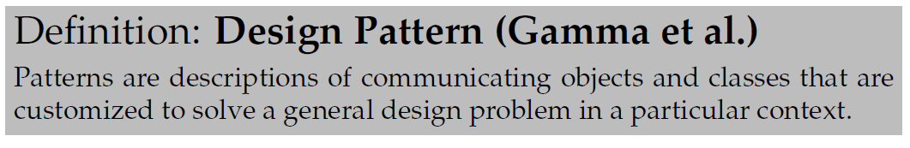
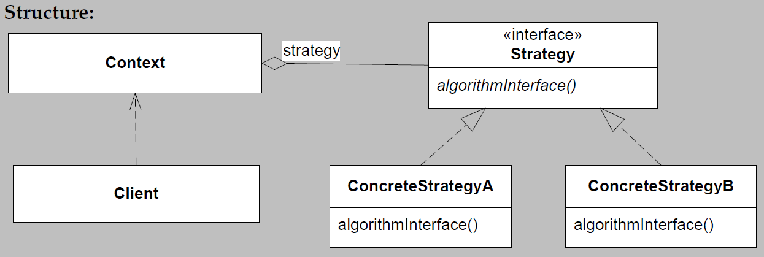
Gamma et al.’s definition
Exercise: How does it relate to…

Slide 3
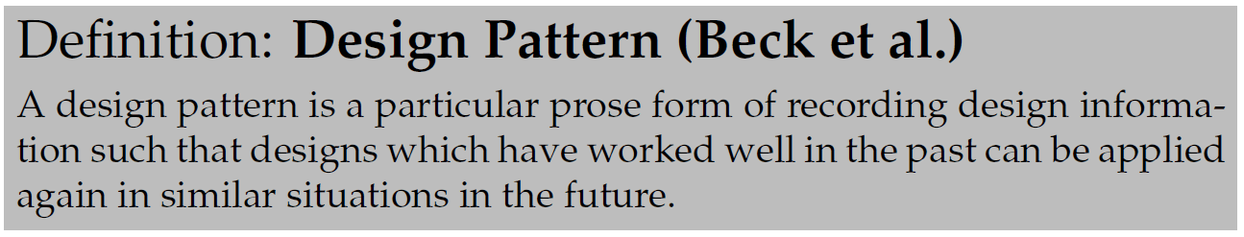
Beck et al.’s Definition
Prose form = “writing template”
The template varies from author to author.
However, must contain
Name
Problem
Solution
Consequences

Slide 4
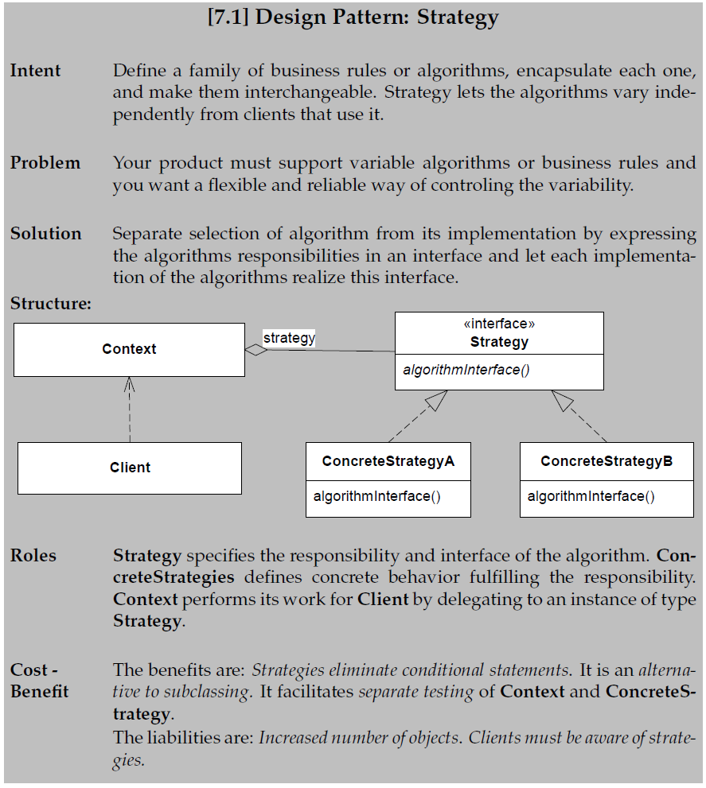
FRS’s template
Intent
Short description
Roles
Responsibilities of each participating object/abstraction in the pattern

Slide 5
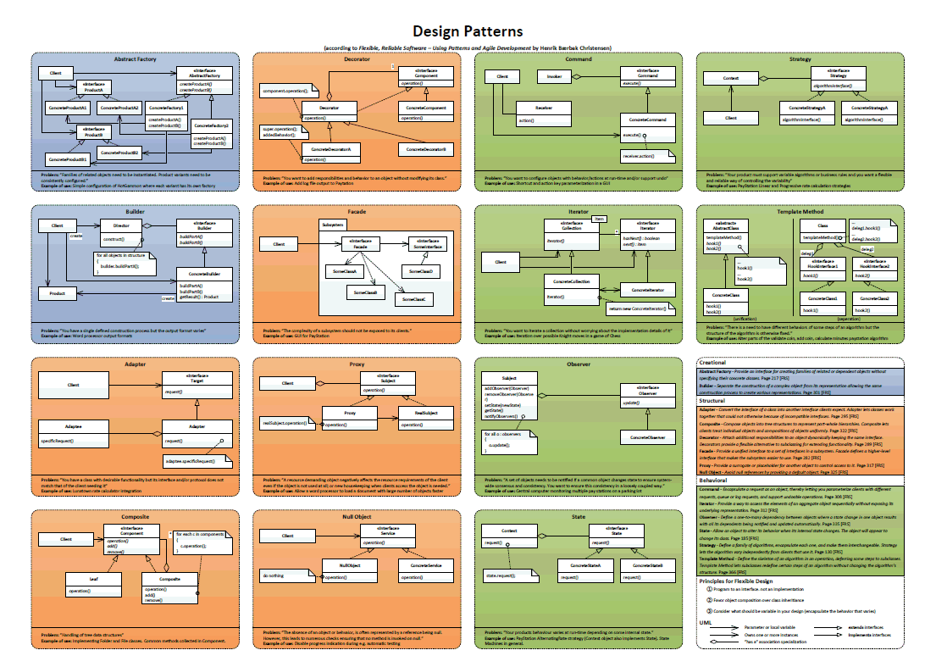
On www.baerbak.com
Simon Kracht: FRS Design Pattern Poster

Slide 6
Differentiating Patterns
Be aware that many patterns are structurally equal – their UML class diagrams are more or less identical!
Patterns are defined by the problem they solve!
Strategy is the problem of
Handling variability of algorithms / business rules, making them interchangeable.

